Slide 1
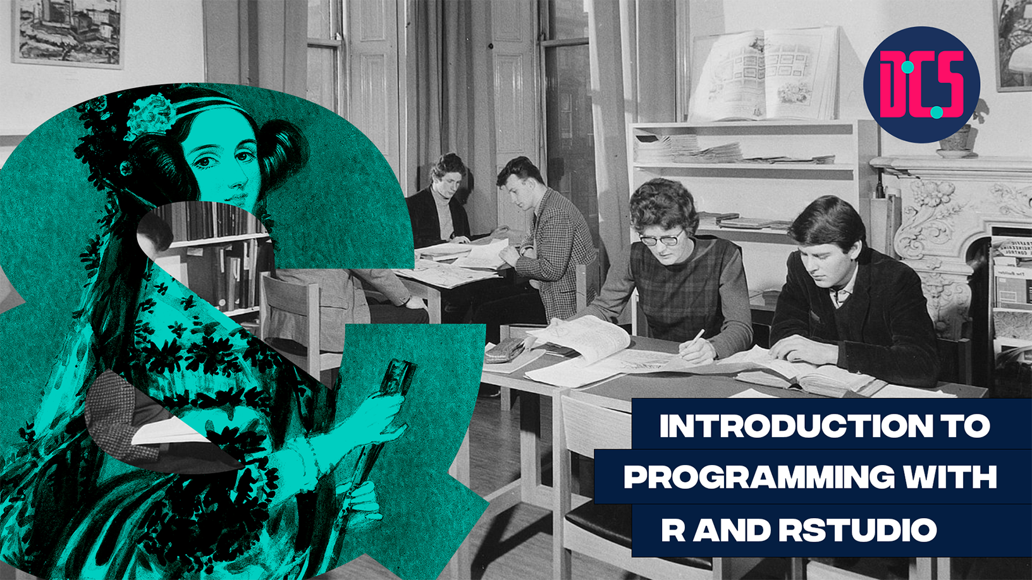
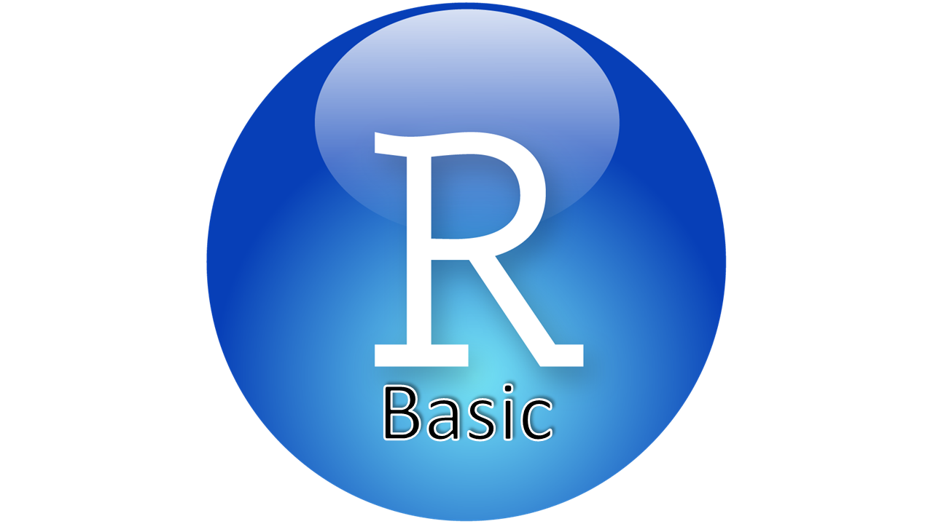

Introduction to R and RStudio
r.m.m.davies@sms.ed.ac.uk
Javiera.Alfaro@ed.ac.uk

Slide 2
Before Starting…
The Workshop
Format: Work through code together on R Studio – discuss questions as we go
Learning outcomes: Get a basic understanding of how to use R to read and modify data
Two parts
24/01/24, 10:00 -12:00
Introduction to R and RStudio
31/01/24, 10:00 – 12:00
Data wrangling and manipulation

Slide 3
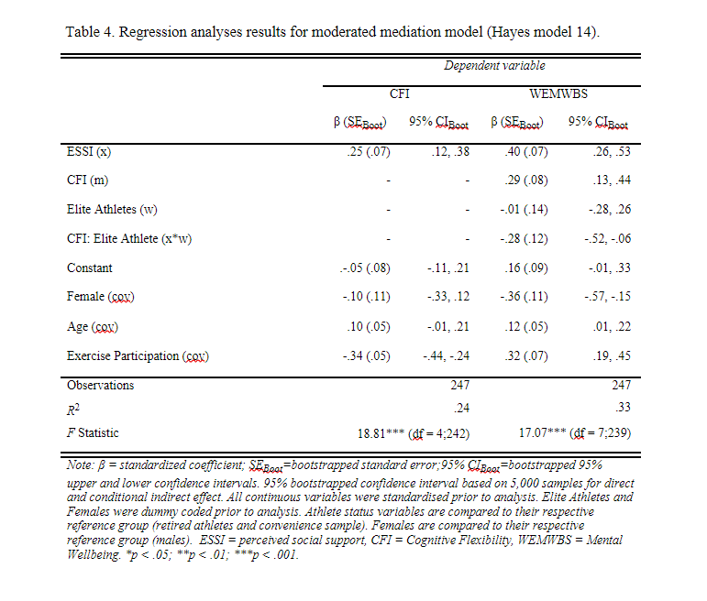
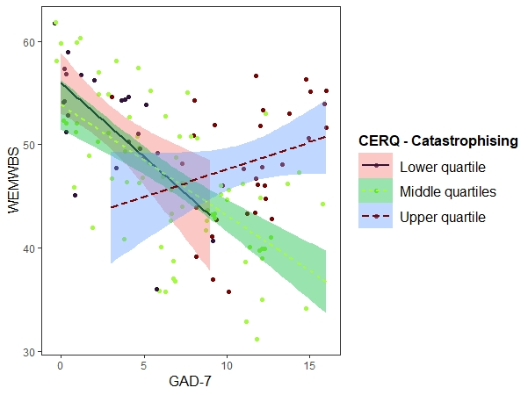
Before Starting…
How we use R for our research
Notes:
Who am I and how and why do I use R?
- former athlete, current clinical sport psychology researcher.
- I use R to manage and perform the analytic sections of my research; all the way from tidying and managing my data, to analysing, exploring and presenting it.
- Analytically, I am interested in interaction effects in regression analyses as a means of understanding the influence of individual context on a generalised pattern.
- I use these strategies to better understand some of the mental health challenges and paradoxes faced by elite athletes whose career and passions revolve around competing in high pressure environments.

Slide 4

What is R and RStudio?
‘a language and environment for statistical computing and graphicsPoints, lines or polygons’
‘an integrated development environment (IDE)’
R is the underlying software, RStudio greatly improves usability
https://www.r-project.org/about.html
https://www.rstudio.com/products/rstudio/

Slide 5
Uses of R and RStudio?
The uses of R are wide ranging
Research
Statistics, graphical visualisation, data wrangling and more
IT
Finance
Social Media
Healthcare
Governmental Departments

Slide 6
Why use R?
Text-based, reproducible.
Extensive, wide range of user-developed packages.
Large & active user community, so very easy to find support if you have difficulties.
An industry standard for data science and statistics, so whether you want to get into academia or business, R is an important skill to have.

Slide 7
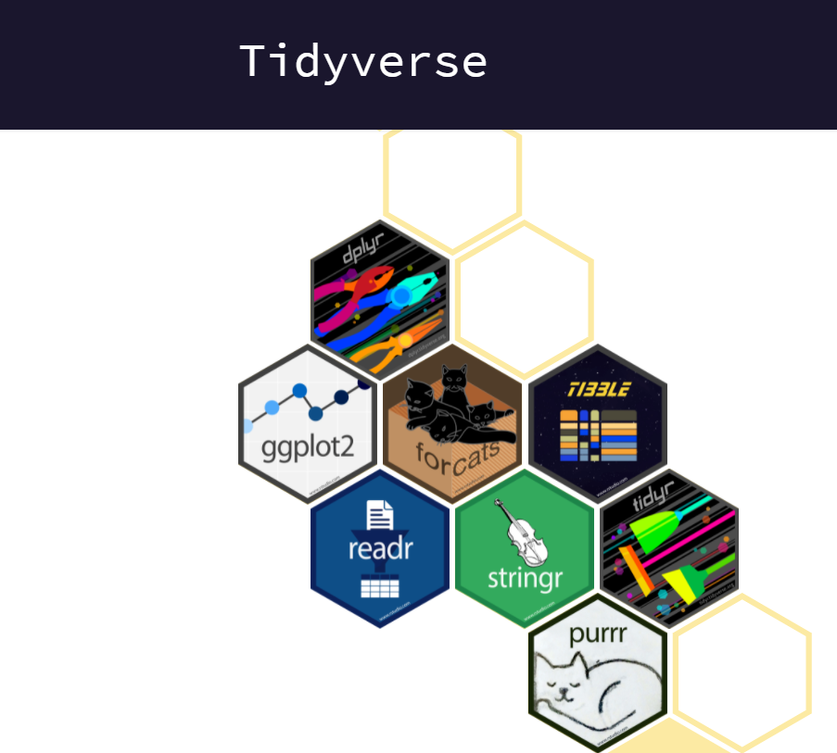
What is R and RStudio? Packages
As open-source software, there are a huge number of packages available through R
Packages contain ready-made useful functions to help us code.
A very commonly used package is ‘tidyverse’
This combines several important packages, and is the main package we will use during the classes
> install.packages(‘tidyverse)
https://support.rstudio.com/hc/en-us/articles/201057987-Quick-list-of-useful-R-packages
https://www.tidyverse.org/
cheatsheets/data-transformation.pdf at main · rstudio/cheatsheets (github.com)

Slide 8
What is R and RStudio? When in doubt
The R environment can seem confusing at first, and the packages and functions overwhelming.
A lot can be learned by playing around! Embrace mistakes.
Whenever in doubt the help() function can be used
Beyond that, search online! It’s unlikely you will be the first person to come across a particular issue

Slide 9
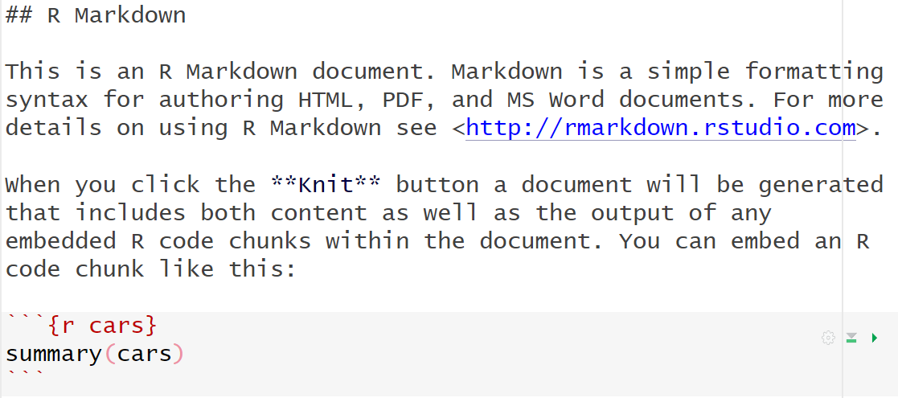
R markdown Documents
Our workshops make use of Rmarkdown documents to store the code scripts.
Rmarkdown documents are very useful, as they allows us to have hybrid code/text documents.
This allows us to do things like write explanations, describe and report our analyses, alongside the code used to conduct our analysis.
From a teaching perspective, it allows us to explain and describe what the code is doing, without cluttering the document with #comments.
We will guide you through R markdown as we introduce R studio.

Slide 10
Projects and Working Directories
Have a separate project for each data analysis.
Creating separate folders for your raw data, your code documents, and your processed data within the project.
When we use projects in R, it will help us control the working directory.
If this seems scary, don’t worry! It took me 6 years before I even paid attention to projects. But knowing about them will help you to organise your work flow/manage your data.
We will cover this within R studio – and revisit during the 2nd session.
https://r4ds.had.co.nz/workflow-projects.html
https://www.rstudio.com/wp-content/uploads/2015/02/data-wrangling-cheatsheet.pdf

Slide 11
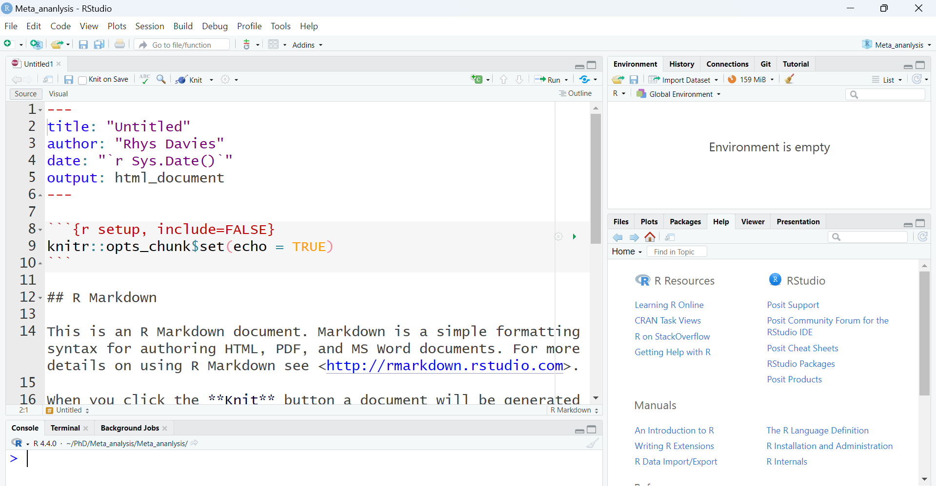
Let’s try it ourselves!

